Slide 1


081100M01002H 图像处理与分析 第一讲: 视觉与图像 (I) 图像处理简介，课程安排与要求，人类视觉机理
杨戈^{1,2}
¹中国科学院大学人工智能学院 ²中国科学院自动化研究所模式识别国家重点实验室
Lecture 1 September 05, 2019

Slide 2
内容提纲
什么是图像？
什么是图像处理？
课程内容概要
课程安排与要求
人类视觉机理
一些与课程有关的重要实用信息
Notes:
As you will see again and again in the class, to understand bioimage informatics depends critically on understanding the biological background of bioimage informatics. This is because bioimage informatics is created to answer biological questions rather than for technological curiosity. If we do not understand the biological questions, we will not be able to understand bioimage informatics. So for this reason we need to build some background knowledge about biology, and specifically for this lecture about cell biology.
For the most part of this course, our discussion on biology will be on a level that will be quite comfortable for you.
After that I will give you some historical perspectives and talk about where does it come from. Then I will discuss the learning objectives that we plan to achieve in this class. And finally I will go through the course syllabus together with you and discuss some details.

Slide 3
什么是图像？
什么是图像处理？
课程内容概要
课程安排与要求
人类视觉机理
一些与课程有关的重要实用信息
Notes:
As you will see again and again in the class, to understand bioimage informatics depends critically on understanding the biological background of bioimage informatics. This is because bioimage informatics is created to answer biological questions rather than for technological curiosity. If we do not understand the biological questions, we will not be able to understand bioimage informatics. So for this reason we need to build some background knowledge about biology, and specifically for this lecture about cell biology.
For the most part of this course, our discussion on biology will be on a level that will be quite comfortable for you.
After that I will give you some historical perspectives and talk about where does it come from. Then I will discuss the learning objectives that we plan to achieve in this class. And finally I will go through the course syllabus together with you and discuss some details.

Slide 4
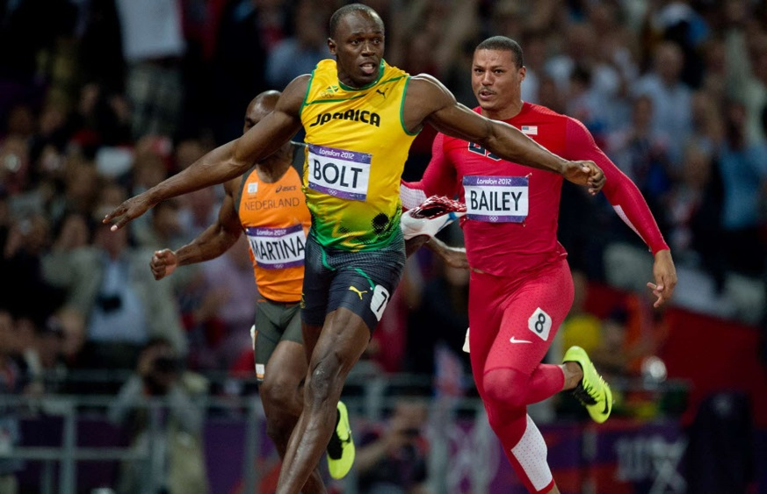
什么是图像？(I)

Slide 5
图像中包含哪些信息？
？？
？？
？？

Slide 6
什么是图像？(II)

Slide 7
什么是图像？(III)
一幅二维图像是一个像素阵列。
一幅二维图像是一个矩阵 → 数学工具: 线性代数, 神经网络
一幅二维图像是一个曲面 (经平滑处理） → 数学工具: 微积分，微分几何…

Slide 8
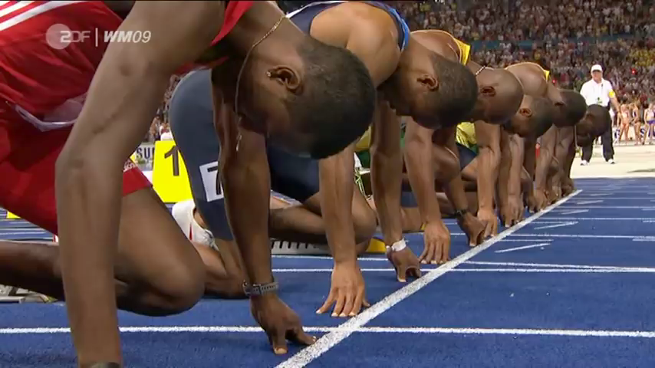
什么是图像？(IV)

Slide 9
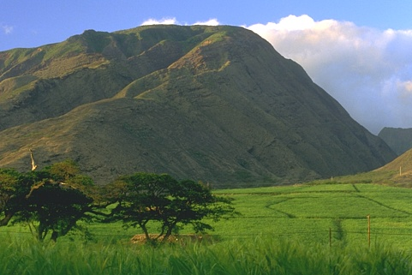
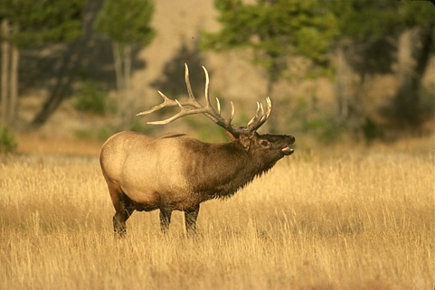

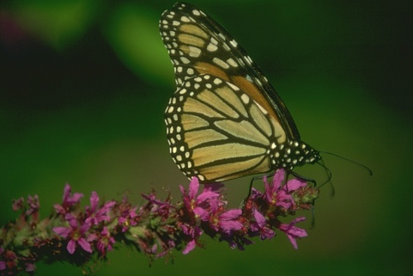
自然场景图像
Berkeley Segmentation Data Set 500
https://www2.eecs.berkeley.edu/Research/Projects/CS/vision/bsds/

Slide 10
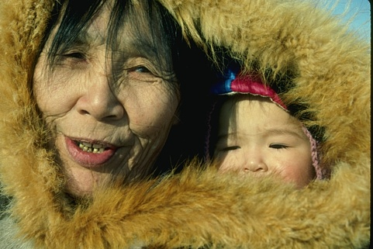
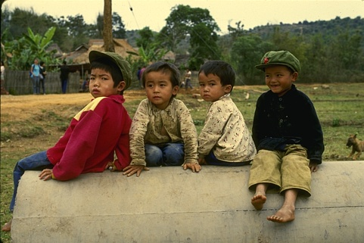
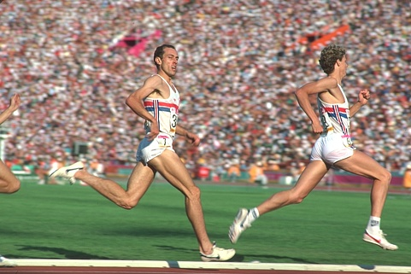
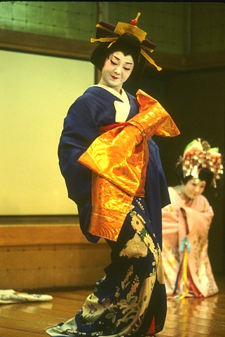
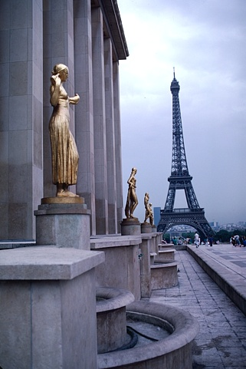
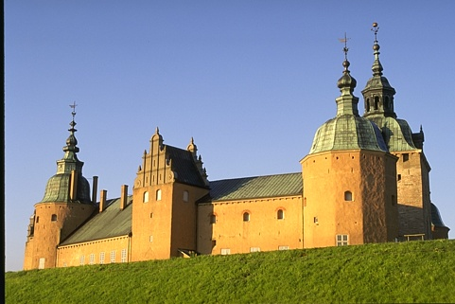
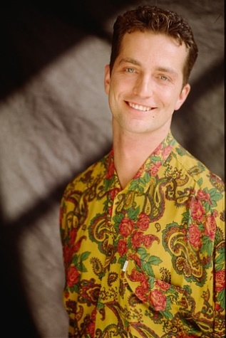
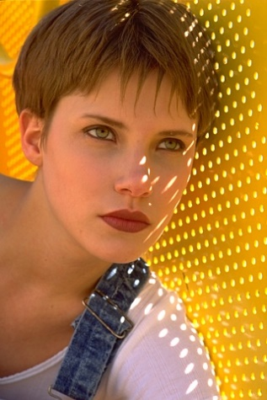
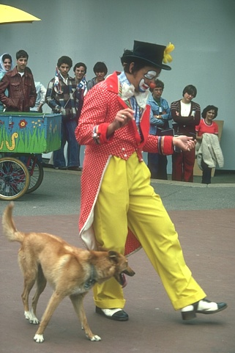

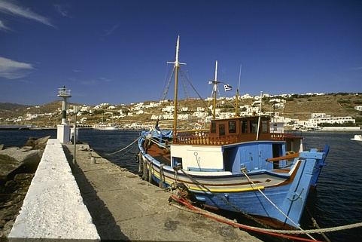
社会场景图像
Berkeley Segmentation Data Set 500
https://www2.eecs.berkeley.edu/Research/Projects/CS/vision/bsds/

Slide 11
图像分割示例 (I)
Arbelaez et al, PAMI, 2010

Slide 12
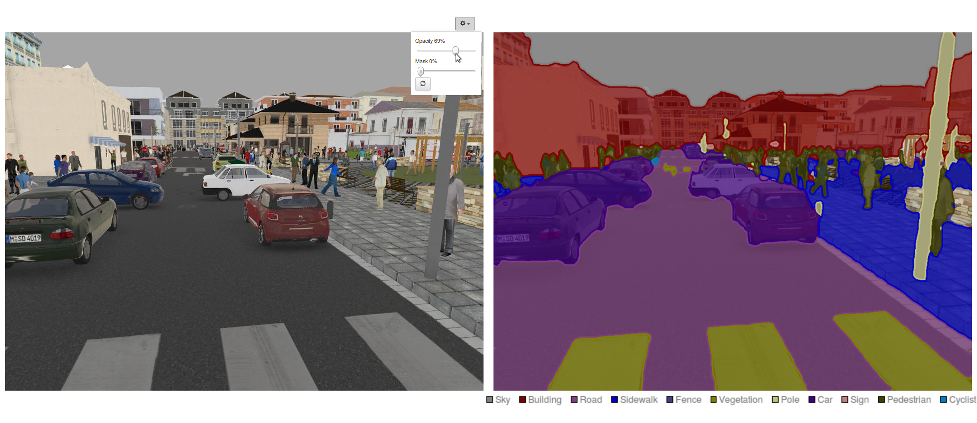
图像分割示例 (II)
https://devblogs.nvidia.com/image-segmentation-using-digits-5/

Slide 13
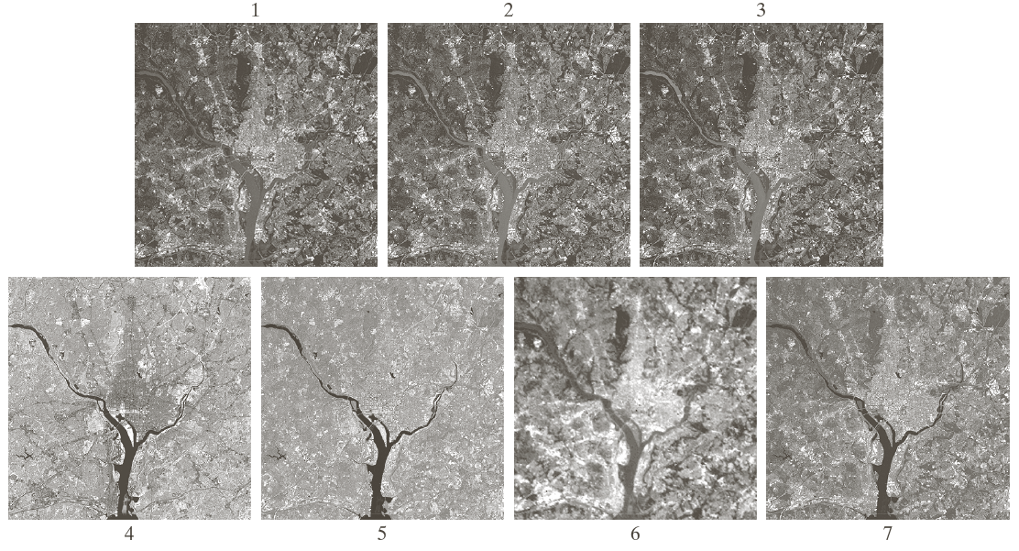
遥感图像示例

Slide 14
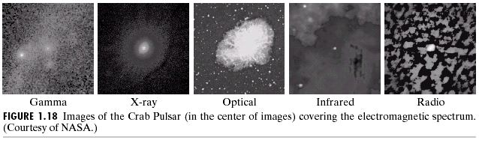
空间应用图像示例

Slide 15
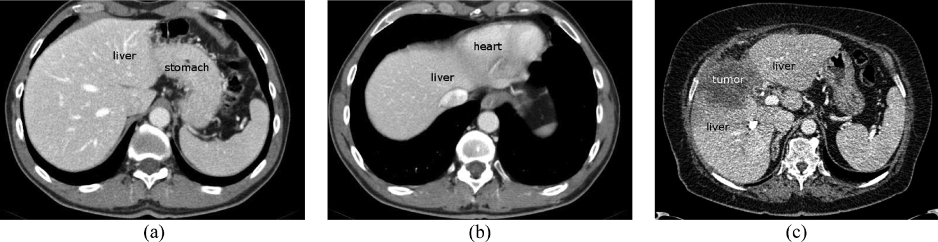
医学图像示例
Heimann et al, Comparison and Evaluation of Methods for Liver Segmentation From CT Datasets, IEEE Trans. Medical Imaging, vol. 28, no. 8, 1251-1265, 2009.

Slide 16
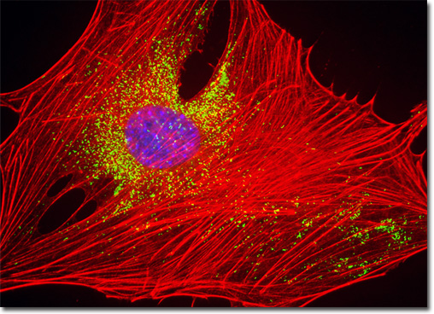
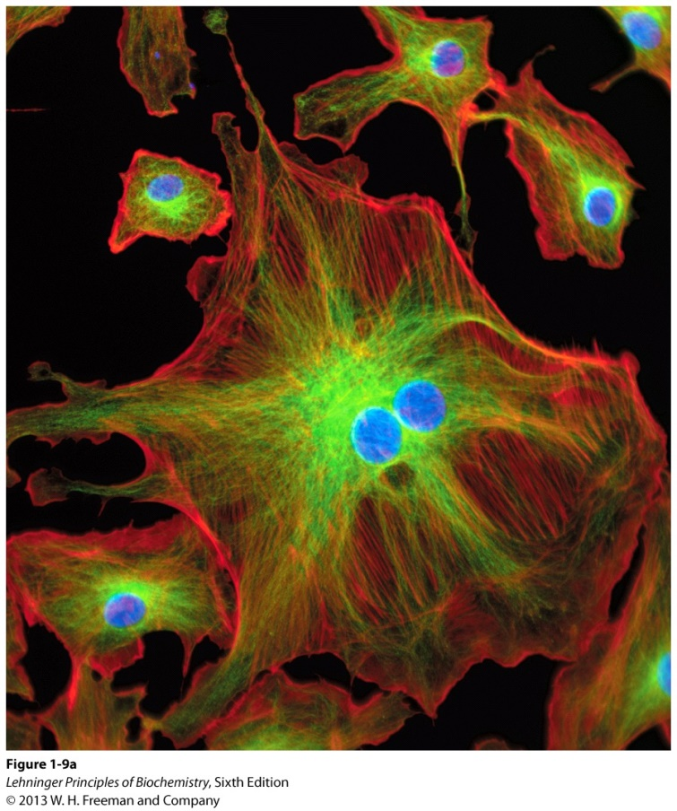
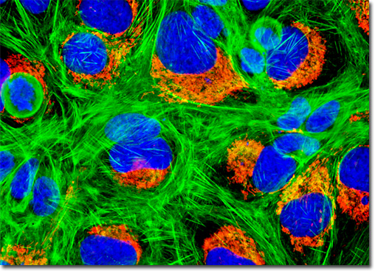
生物图像示例 (I)
Embryonic Swiss Mouse Fibroblast Cells (3T3)
Human Bone Osteosarcoma Cells (U-2 OS)
http://micro.magnet.fsu.edu/primer/techniques/fluorescence/gallery/cells/3t3/3t3cellslarge.html
Notes:
Metabolism: is the entire set of enzyme-catalyzed transformation of organic molecules in living cells.
Metabolites: a chemical intermediate in the enzyme-catalyzed reactions of metabolism.

Slide 17
生物图像示例 (II)

Slide 18
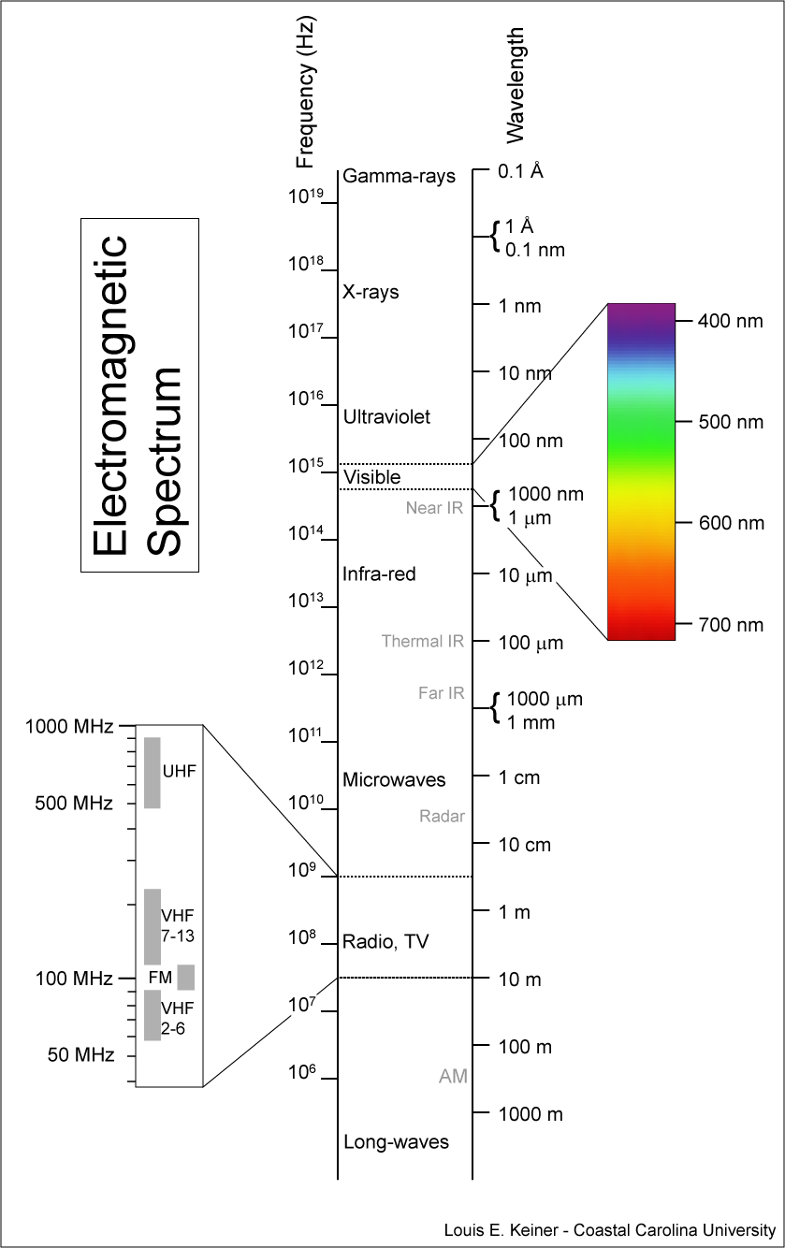
按照光子能量排列的电磁波谱
光子能量的普朗克定律：
光波长越短光子能量越高。
h: 普朗克常数; 6.626×10⁻³⁴J·s v: 光频率; λ: 光波长
c: 光速 光子能量 = 3.973 ×10⁻¹⁹J at 500nm

Slide 19
X射线成像

Slide 20
总结：图像数据
视觉是人类感知的最高级形式，图像在人类认知中起最为重要的作用。
一幅图像可以定义为一个两维函数 I(x,y), 其中 (x,y) 为像素在图像坐标系中的坐标，I(x,y)为像素灰度。
图像数据在众多应用领域具有重要价值与意义。
不同应用领域在图像信息提取方面有共性也有不同。

Slide 21
什么是图像？
什么是图像处理？
课程安排与要求
人类视觉机理
一些与课程有关的重要实用信息
Notes:
The main goal of this lecture is to introduce to you what bioimage informatics is and what this class is about. Here is an outline of this lecture.
As you will see again and again in the class, to understand bioimage informatics depends critically on understanding the biological background of bioimage informatics. This is because bioimage informatics is created to answer biological questions rather than for technological curiosity. If we do not understand the biological questions, we will not be able to understand bioimage informatics. So for this reason we need to build some background knowledge about biology, and specifically for this lecture about cell biology.
For the most part of this course, our discussion on biology will be on a level that will be quite comfortable for you.
After that I will give you some historical perspectives and talk about where does it come from. Then I will discuss the learning objectives that we plan to achieve in this class. And finally I will go through the course syllabus together with you and discuss some details.

Slide 22
图像处理的重要性 (I)
改善图示信息以便人们进行解释
图像
图像处理
图像

Slide 23
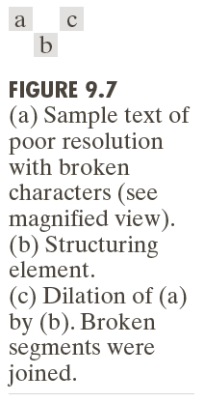
图像处理的重要性 (II)
为存储，传输和表示而对于图像进行处理，以便于机器自动理解。
图像
图像处理
图像

Slide 24
图像处理的重要性 (III)
图像
图像处理
特征
Arbelaez et al, PAMI, 2010

Slide 25
图像处理的不同层次
低级处理 - 图像降噪，对比度增强，图像锐化
- 输入输出均为图像
中级处理
- 图像属性提取
- 输入为图像，输出为图像属性
高级处理 (计算机视觉，人工智能） - 图像理解

Slide 26
图像处理与计算机视觉/人工智能的关系
图像处理通常作为计算机视觉的前处理，是后者的基础。
计算机视觉与图像处理的主要区别在于计算机视觉的目的是对于图像的理解。
对于视觉信息的进一步认知推理属于人工智能的范畴。
这些区分是概念性的，不是绝对的。

Slide 27
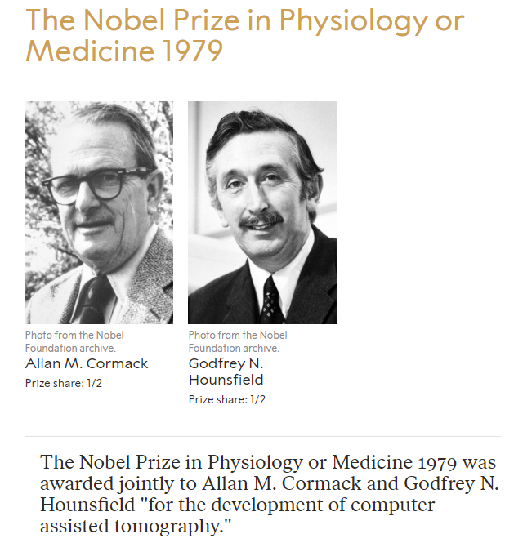
图像处理的简单历史回顾
真正意义上的图像处理起源于20世纪60年代初期，空间应用。
- 计算能力与存储能力
20世纪60年代末70年代初开始用于医学成像，遥感及天文学等领域。

Slide 28
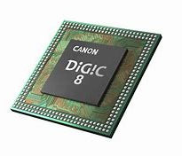
通用图像处理系统的组成
https://snapshot.canon-asia.com/article/en/canon-announces-the-eos-m50-new-digic-8-image-processor-4k-movie-shooting

Slide 29
什么是图像？
什么是图像处理？
课程内容概要
课程安排与要求
人类视觉机理
一些与课程有关的重要实用信息
Notes:
The main goal of this lecture is to introduce to you what bioimage informatics is and what this class is about. Here is an outline of this lecture.
As you will see again and again in the class, to understand bioimage informatics depends critically on understanding the biological background of bioimage informatics. This is because bioimage informatics is created to answer biological questions rather than for technological curiosity. If we do not understand the biological questions, we will not be able to understand bioimage informatics. So for this reason we need to build some background knowledge about biology, and specifically for this lecture about cell biology.
For the most part of this course, our discussion on biology will be on a level that will be quite comfortable for you.
After that I will give you some historical perspectives and talk about where does it come from. Then I will discuss the learning objectives that we plan to achieve in this class. And finally I will go through the course syllabus together with you and discuss some details.

Slide 30
数字图像处理的基本步骤

Slide 31
课程内容 （I）
视觉与图像 （6 学时）
数字图像的基本概念 （6学时）
图像变换 + 深度学习简介（6学时）
图像的统计描述 （3学时）
图像增强 （3学时）
图像的形态学处理 （3学时）
图像分割与边缘检测 （3学时）
图像滤波 （3学时）

Slide 32
课程内容 （II）
几何多尺度分析 （6学时）
图像复原与重建 （6学时）
图像压缩与编码 （3学时）
图像特征表示 （3学时）
图像处理中的深度学习方法 （6学时）
课程考试（3学时）

Slide 33
什么是图像？
图像处理简介
课程内容概要
课程安排与要求
人类视觉机理
一些与课程有关的重要实用信息
Notes:
The main goal of this lecture is to introduce to you what bioimage informatics is and what this class is about. Here is an outline of this lecture.
As you will see again and again in the class, to understand bioimage informatics depends critically on understanding the biological background of bioimage informatics. This is because bioimage informatics is created to answer biological questions rather than for technological curiosity. If we do not understand the biological questions, we will not be able to understand bioimage informatics. So for this reason we need to build some background knowledge about biology, and specifically for this lecture about cell biology.
For the most part of this course, our discussion on biology will be on a level that will be quite comfortable for you.
After that I will give you some historical perspectives and talk about where does it come from. Then I will discuss the learning objectives that we plan to achieve in this class. And finally I will go through the course syllabus together with you and discuss some details.

Slide 34
教学方式 (I)
课堂授课 首席授课教师：彭思龙 共同授课教师 I：杨戈
共同授课教师 II：胡晰远
平时作业 - 平均~1.5周一次编程小作业，共~10次作业 - 平均~30-40个学生配备一名教学助理，负责批改作 业和答疑

Slide 35
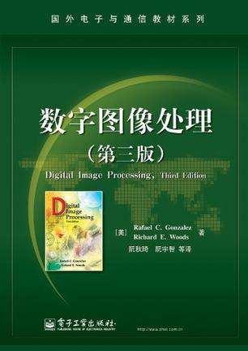
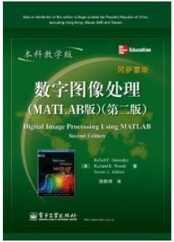
教学方式 (II)
推荐教材
-冈萨雷斯，伍兹著， 数字图像处理（第3版), 电子工业出版社，2010.
-冈萨雷斯，伍兹著， 数字图像处理 (MATLAB版), 电子工业出版社，2014.

Slide 36
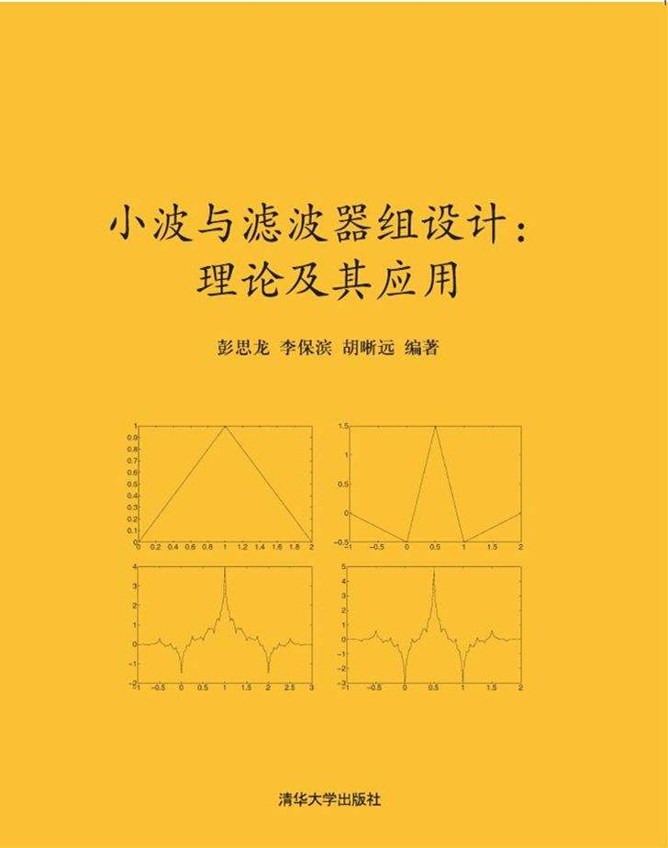
教学方式 (II)
参考书 - 彼得鲁著，赖剑煌译，数字图像处理疑难解析——计算机科学丛书 ，机械工业出版社，2005.
- 彭思龙，李宝滨，胡晰远著，小波与滤波器组设计：理论及其应用，清华大学出版社，2017.

Slide 37
考核方式
平时作业 （~30%）
闭卷考试（~70%）

Slide 38
什么是图像？
图像处理简介
课程内容概要
课程安排与要求
人类视觉机理
一些与课程有关的重要实用信息
Notes:
The main goal of this lecture is to introduce to you what bioimage informatics is and what this class is about. Here is an outline of this lecture.
As you will see again and again in the class, to understand bioimage informatics depends critically on understanding the biological background of bioimage informatics. This is because bioimage informatics is created to answer biological questions rather than for technological curiosity. If we do not understand the biological questions, we will not be able to understand bioimage informatics. So for this reason we need to build some background knowledge about biology, and specifically for this lecture about cell biology.
For the most part of this course, our discussion on biology will be on a level that will be quite comfortable for you.
After that I will give you some historical perspectives and talk about where does it come from. Then I will discuss the learning objectives that we plan to achieve in this class. And finally I will go through the course syllabus together with you and discuss some details.

Slide 39
人眼的结构 (I)
人眼由三层膜包裹 - 角膜(cornea)与巩膜(sclera) - 脉络膜 (choroid) - 视网膜 (retina)
脉络膜负责供血与营养
虹膜(iris) 负责控制入光量 - 2~8mm
睫状体(ciliary body)，睫状肌(ciliary muscle)和晶状体(lens)负责光学调节

Slide 40
人眼的结构 (II)
视网膜：光感受器
锥状体(cones) - 600~700万个 - 对颜色高度敏感 - 负责亮视觉 - 感兴趣的物体落在中央凹(fovea)
杆状体(rods) - 7500~15000万个 - 没有彩色感觉 - 负责暗视觉/微光视觉

Slide 41
视网膜中锥状体和杆状体的分布

Slide 42
眼睛中图像的形成
焦距： 14~17mm

Slide 43
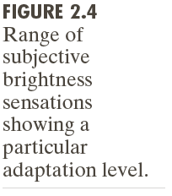
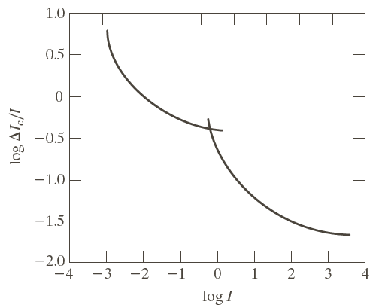
主观亮度与实际光强的关系
主观亮度是光强的对数函数
人眼在暗视觉(scotopic)条件下的敏感度低于亮视觉(photopic)条件下的敏感度

Slide 44
人眼的马赫带效应

Slide 45
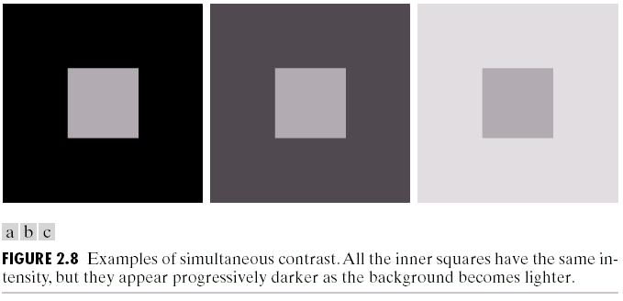
人眼的同时对比效应

Slide 46
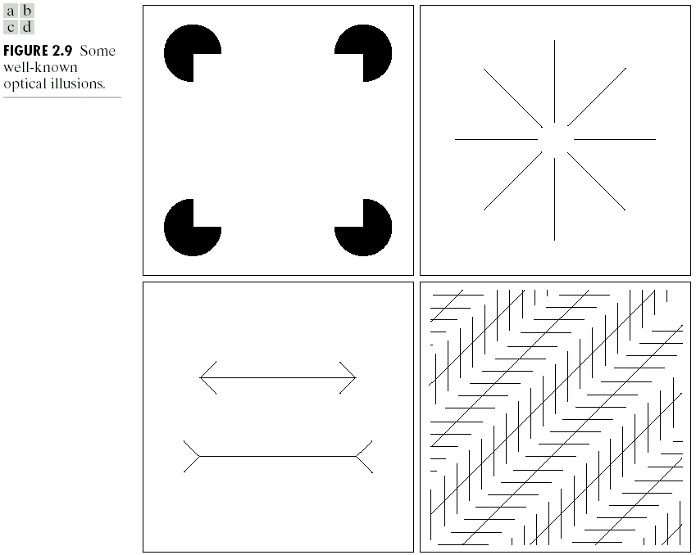
人眼的视错觉 (感知组织 Perceptual Organization)

Slide 47
参考文献

Slide 48
生成图像的电磁波谱
光子能量的普朗克定律：
光波长越短光子能量越高。
h: 普朗克常数; 6.626×10⁻³⁴J·s v: 光频率; λ: 光波长
c: 光速 光子能量 = 3.973 ×10⁻¹⁹J at 500nm

Slide 49
什么是图像？
图像处理简介
课程内容概要
课程安排与要求
人类视觉机理
一些与课程有关的重要实用信息
Notes:
The main goal of this lecture is to introduce to you what bioimage informatics is and what this class is about. Here is an outline of this lecture.
As you will see again and again in the class, to understand bioimage informatics depends critically on understanding the biological background of bioimage informatics. This is because bioimage informatics is created to answer biological questions rather than for technological curiosity. If we do not understand the biological questions, we will not be able to understand bioimage informatics. So for this reason we need to build some background knowledge about biology, and specifically for this lecture about cell biology.
For the most part of this course, our discussion on biology will be on a level that will be quite comfortable for you.
After that I will give you some historical perspectives and talk about where does it come from. Then I will discuss the learning objectives that we plan to achieve in this class. And finally I will go through the course syllabus together with you and discuss some details.

Slide 50
本领域的重要国际会议
http://conferences.visionbib.com/Iris-Conferences.html
IEEE International Conference on Image Processing (ICIP)
IEEE International Conference on Acoustics, Speech, and Signal (ICASSP)
IEEE International Conference on Biomedical Imaging (ISBI)
Medical Image Computing and Computer Assisted Intervention Society Meeting (MICCAI)
IEEE CVPR
ICCV, ECCV, ACCV

Slide 51
本领域的重要专业杂志
International Journal of Computer Vision (IJCV)
IEEE Transactions on Pattern Analysis & Machine Intelligence (PAMI)
IEEE Transactions on Image Processing
IEEE Transactions on Medical Imaging -

Slide 52
课程有关的网上资源
图像处理教科书网站 http://www.imageprocessingplace.com/
http://www.imageprocessingplace.com/root_files_V3/publications.htm

Slide 53
有关的网上课程
Stanford University EE368/CS232 Digital Image Processing
https://web.stanford.edu/class/ee368/index.html
UC Berkeley
http://inst.eecs.berkeley.edu/~ee225b/sp19/
Purdue University
https://engineering.purdue.edu/~bouman/ece637/
Northwestern University
https://www.mccormick.northwestern.edu/electrical-computer/courses/descriptions/420.html
University of Waterloo
https://ece.uwaterloo.ca/~ece417/index.html

Slide 54
Questions?

Slide 55
MATLAB Overview
MATLAB stands for "matrix laboratory“, a product of MathWorks Inc. (Natick, Massachusetts).
It is both an interpreted language and a development and application environment.
History of MATLAB
- First developed in 1970's by Cleve Moler, coauthor of LINPACK & EISPACK
- First written in FORTRAN; Later rewritten in C
- Commercial development initiated by Jack Little - MathWorks was founded in 1984.
- In 2000, rewritten based on LAPACK.
Sources:
http://www.mathworks.com/company/aboutus/founders/clevemoler.html http://www.mathworks.com/company/aboutus/founders/jacklittle.html
http://www.mathworks.com/company/newsletters/news_notes/clevescorner/dec04.html

Slide 56
Advantages of MATLAB (I)
MATLAB provides reliable and efficient numerical computation with friendly user interfaces. - Maple, Mathematica traditionally strong in symbolic computation (computer algebra)
Examples of numerical computation issues - Precision; numerical stability - Underflow and overflow - Code quality (debugging, exception handling) - Code efficiency (optimization)
Visit www.netlib.org for more information about different numerical packages.

Slide 57
Advantages of MATLAB (II)
Fast prototyping: MATLAB is an interpreted language
Extensive toolboxes
Versatile graphics
Cross-platform: Windows, Unix, Linux, Mac OS
Support parallel computing
Support object oriented programming
Large groups of users MATLAB file exchange (use with caution)
http://www.mathworks.com/matlabcentral/

Slide 58
MATLAB Toolboxes (I)
A large collection of basic math functions are provided in the MATLAB base package.
Function extensions are packaged as toolboxes.
Signal & image processing; Computer vsion
- Signal processing toolbox - Image processing toolbox - Computer vision toolbox
- Statistics and machine learning toolbox
- Neural network toolbox (for deep learning)
Math and optimization - Optimization toolbox - PDE toolbox

Slide 59
MATLAB Toolboxes (II)
Statistics & data analysis - Curve fitting toolbox
Third party toolboxes - Pattern recognition toolbox: www.prtools.org - Wavelet toolbox: http://www-stat.stanford.edu/~wavelab/

Slide 60
Limitations of MATLAB
Operation details are hidden.
Limited efficiency: MATLAB is an interpreted language. - Compiler also available - Can use MEX (MATLAB executable) to call DLL implemented in C
Lack of properties to support large scale software development
E.g. Implicit & dynamic data type
MATLAB is widely used in image processing and computer vision.
MATLAB is the required implementation language for this class.

Slide 61
Learning MATLAB
How to write a MATLAB function - Many videos are available
Some references - There are many MATLAB tutorials online and books available. - Kermit Sigmon, MATLAB Primer, 3rd ed. - MATLAB User’s Guide.
Reminder: MATLAB computation results can be saved in .mat files and loaded back.
Reminder: MAT files are exchangeable on different platforms.

Slide 62
Getting Help with MATLAB
Read related references and practice first.
For a specific function, it is often helpful to look in MATLAB online help.
For a general question, it is often helpful to check related toolbox manuals.
If none of these works, direct your questions to the instructor.

Slide 63
A Partial List of Resources
A MATLAB Primer (3/e) by Kermit Sigmon
Free video-based tutorials on MATLAB:
http://www.mathworks.com/academia/student_center/tutorials/
Plot gallery with source code (by clicking on the figures): http://www.mathworks.com/discovery/gallery.html
8th Edition MATLAB Primer: http://www.mathworks.com/support/books/book52873.html?category=17&language=1
Free online book to learn MATLAB by Cleve Moler, creator of MATLAB: http://www.mathworks.com/moler/exm/chapters.html

